Slide 1
Thomas Day
State Historic Site

Slide 2
Who was Thomas Day?
Thomas Day was a Free Person of Color and a Cabinetmaker from Dinwiddie County, Virginia. He was born in 1801 and died sometime in 1861.
A cabinetmaker is someone who makes furniture.
We don’t have any photographs of Thomas Day, so we don’t know exactly what he looked like.

Slide 3
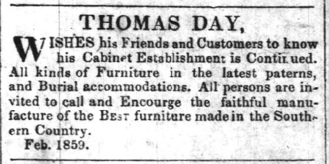
What did it mean to be a free person of color?
Thomas Day was born free, meaning that he was not enslaved
like many African Americans in North Carolina.
Even though Thomas Day was technically free, he still faced discrimination and many legal obstacles that prevented him from being considered equal to White individuals.
Thomas Day had to submit a petition in 1830 to bring his new wife, Aquilla, into North Carolina due to an 1826 law that prevented Free People of Color from moving into the State.
Thomas Day was able to own property and run his cabinetmaking business as a Free Person of Color. He was also able to legally enslave other people; in 1850, he owned at least 14 enslaved individuals.

Slide 4
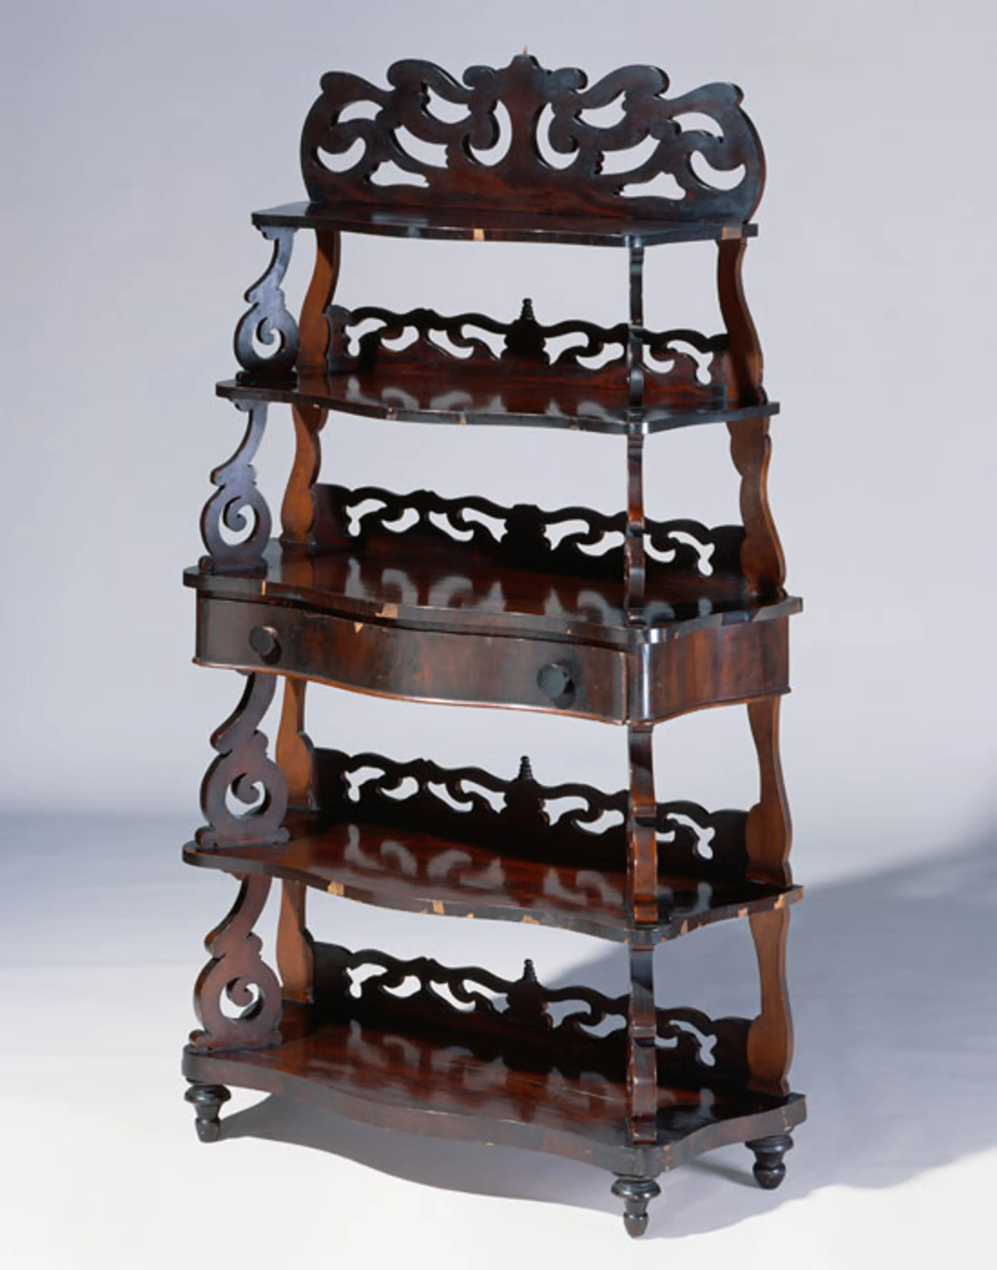
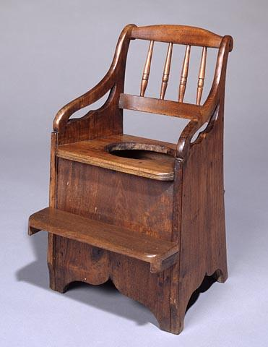
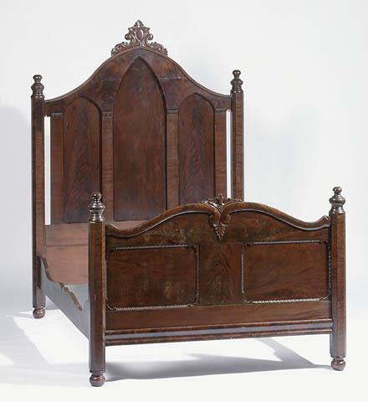
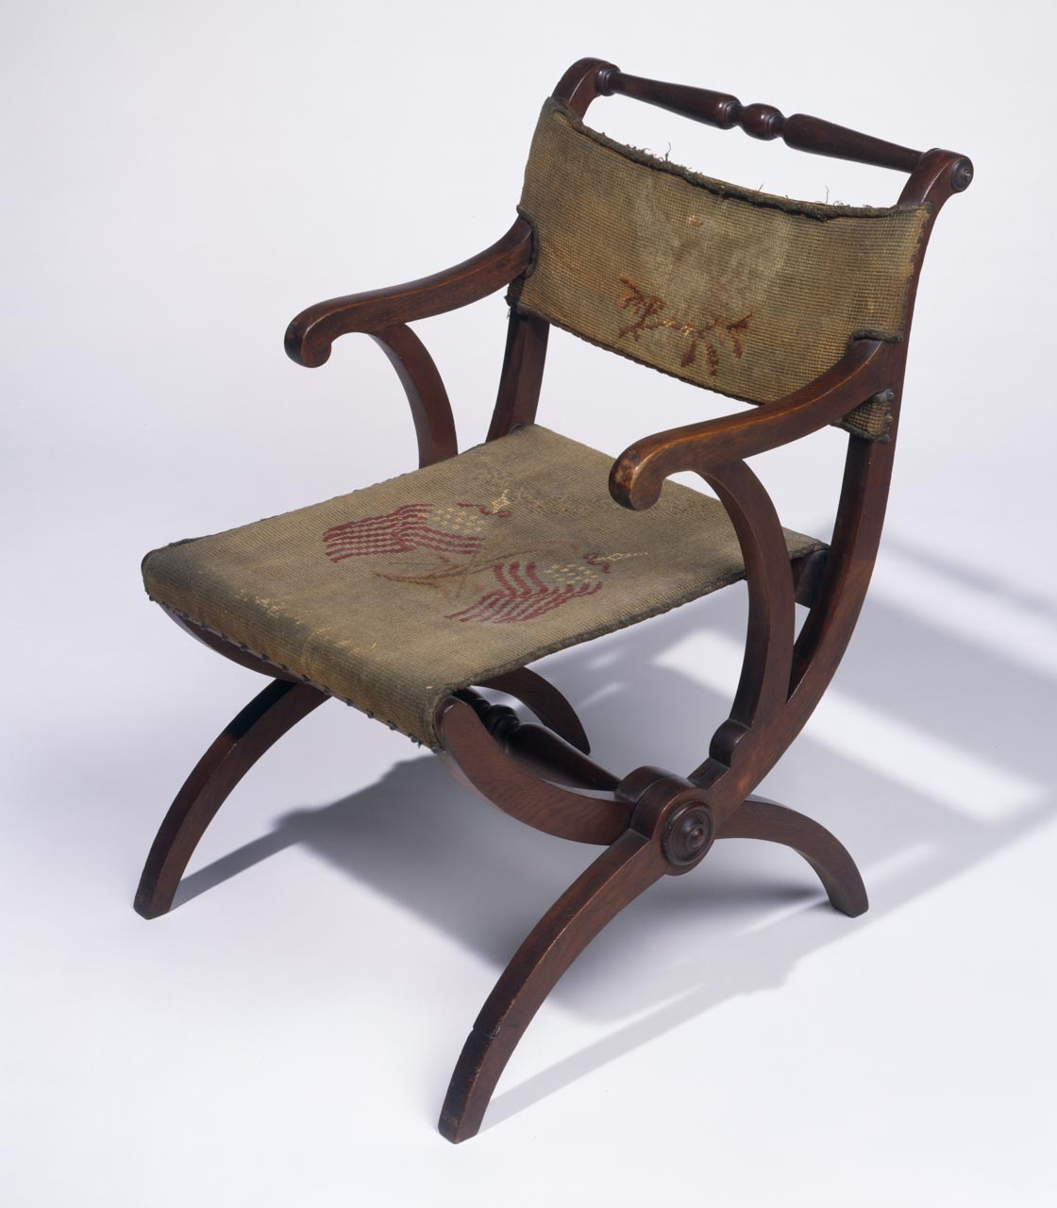
Thomas Day Furniture
Question: Do you have items at home like the ones below? How do they look similar or different?
Whatnot Shelf
Commode
Bedstead
Folding Chair

Slide 5
Why is Thomas Day important?
Thomas Day was extremely successful as a craftsman and businessman. He was one of the largest producers of furniture in the mid-19th century.
Thomas Day’s story gives us insight into the lives of free Black people before the Civil War.
Question: Why might historians not know very much about Free People of Color in North Carolina?
What are some barriers that you might face when trying to research people like Thomas Day?

Slide 6
The Union Tavern
The Union Tavern was built in 1818 in Milton, NC. Thomas Day purchased the building in 1848 and used it as his family home and workshop until 1858.
The Tavern unfortunately experienced a fire in 1989 that destroyed most of the building.

Slide 7
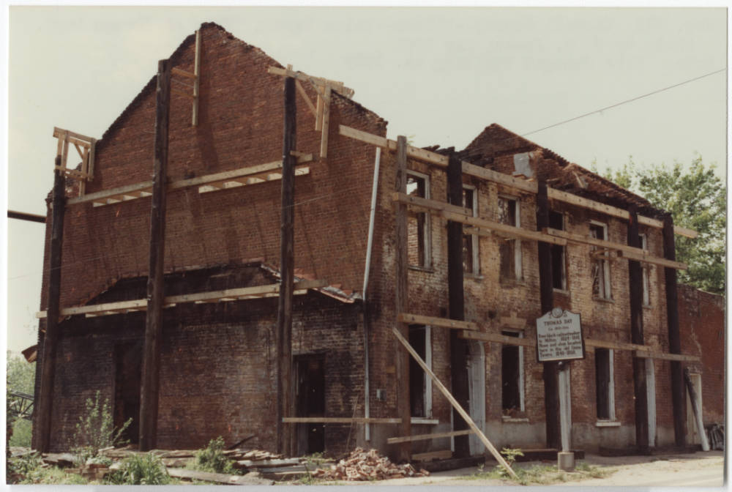
Immediately after the fire in 1989…

Slide 8
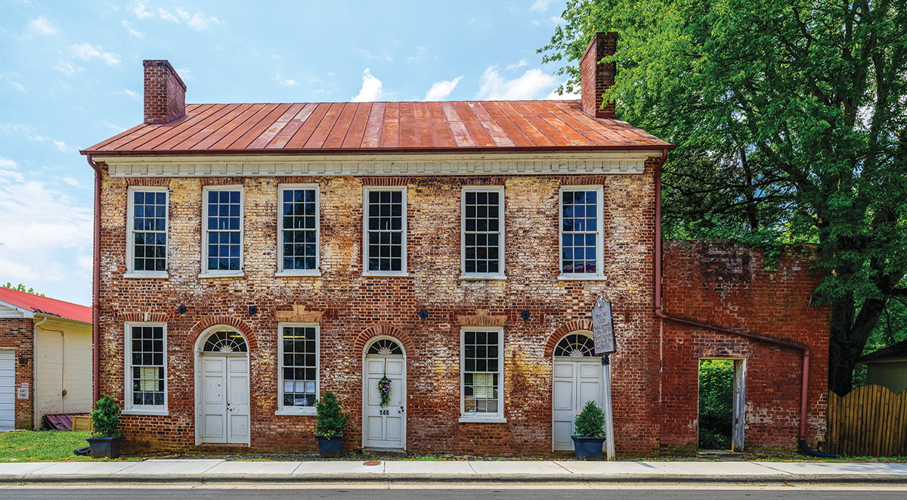
After lots of hard work restoring the building, this is what the Union Tavern looks like today!
We still have a lot of work to do to restore this historic building and make it into a museum for you all to explore and learn more about Thomas Day…
But we need your help!

Slide 9
Pre-visit activity: Build-A-Museum
We need your help while we are hard at work to get your local Historic Site up and running…
Part One: Answer the Discussion Questions and use them as a guide for Part Two.
Part Two: You get to be the Historian! Design a Museum or Historic Site with yourself or a historical figure you have learned about in class as the subject. Fill out the corresponding worksheet.

Slide 10
Pre-Visit Activity: Build-A-Museum Part One
Why are museums important?
Who are museums for?
What kinds of stories should museums tell?
Discuss: With a group or a partner, answer these questions.
(Hint: There are no wrong answers!)

Slide 11
Build-A-Museum Part Two
Step One: Pick a Figure
Step two: Design
Step Three: Reflect
This can be yourself, or an important historical figure you have learned about in class.
Answer the important questions about physical appearance, location, and artifacts or displays that you might want to have in your museum.
Consider potential interpretation in your design.
Reflect on the histories you would like to tell at your museum.
Who might be included in the interpretation besides your main subject?
Think about ways that your museum could serve your community.
Interpretation is how we communicate the meaning and stories behind our museum’s artifacts or displays.

